Slide 1
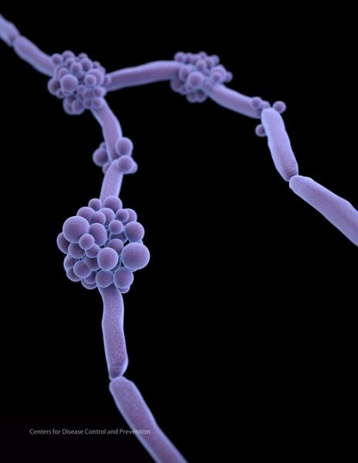
Candida auris: Emergence and antimicrobial resistance
BIS15L Course Project Winter 2022
Group 8: Kelsey Martin & Sidney Parel

Slide 2
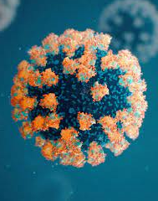
About Candida auris
Emerging pathogen
Antimicrobial Resistance
Coinfections with COVID-19
Prevalence & survival in hospital environments
New strain of the Candida fungi family
Causes Candidiasis in immunocompromised people
35-80% mortality rate in ICU patients (Xiao et al. 2019)
Prevalence increasing since the early 2000’s
High rates of drug resistance
difficult to treat
Outbreaks reported in COVID-19 units of acute care hospitals
Higher risk of bloodstream infection
Survives on/colonizes hospital surfaces & implanted medical devices
Due to ability to form biofilms (Horton et al 2020)
Notes:
Xiao, Z., Wang, Q., Zhu, F. et al. Epidemiology, species distribution, antifungal susceptibility and mortality risk factors of candidemia among critically ill patients: a retrospective study from 2011 to 2017 in a teaching hospital in China. Antimicrob Resist Infect Control 8, 89 (2019). https://doi.org/10.1186/s13756-019-0534-2
Horton, Mark V, and Jeniel E Nett. “Candida auris infection and biofilm formation: going beyond the surface.” Current clinical microbiology reports vol. 7,3 (2020): 51-56. doi:10.1007/s40588-020-00143-7
Coinfection w/ COVID-19: may be related to changes in routine infection control practices during the COVID-19 pandemic, including limited availability of gloves and gowns, reuse or extended use of these items, and changes in cleaning and disinfection practices. Screening for C. auris colonization, an important part of containment efforts, has been more limited as healthcare facilities and health departments have been responding to COVID-19 https://www.cdc.gov/fungal/covid-fungal.html

Slide 3
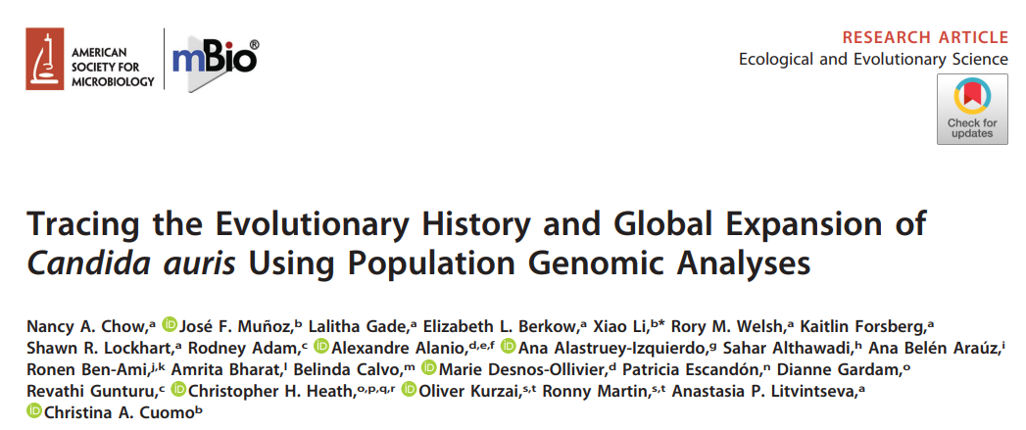
Data Sets
2004-2018
2016-2022
CDC statewide case counts
Made nationally notifiable (voluntary reporting) in 2018
Currently reportable (required reporting) in some states
NCBI Pathogen Detection Isolates Browser
Location, isolation source, date, and SNP cluster
2020 paper with data including date, location of known isolates, drug resistance, and AMR gene mutations
https://microreact.org/project/Candidaauris

Slide 4

Drug Resistance and AMR Gene Mutations
Notes:
Starting with drug resistance bc it is part of why the pathogen is so concerning

Slide 5
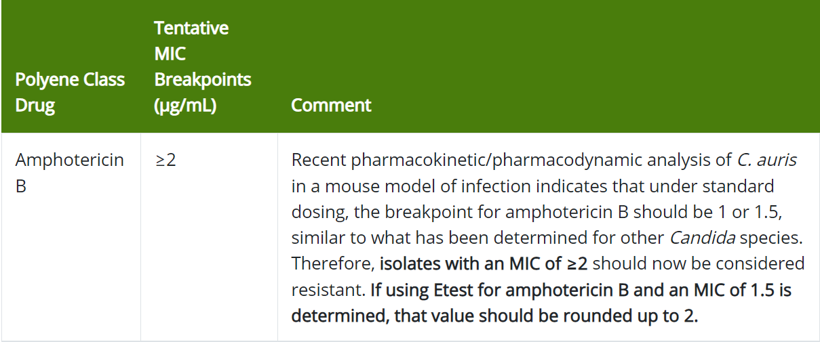
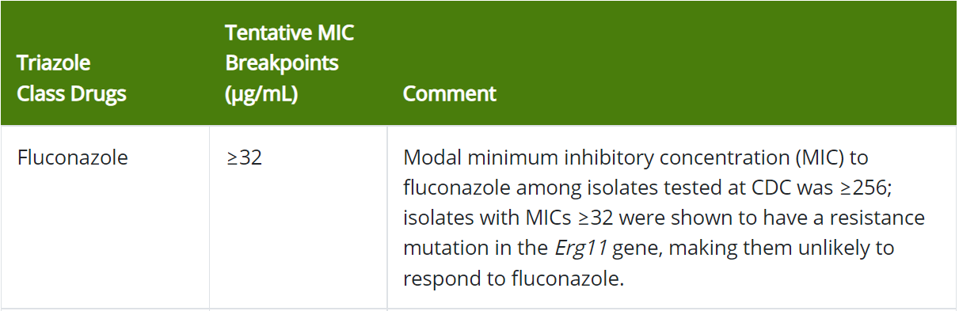
Drug Resistance - Background
Minimum Inhibitory Concentration (MIC)
Antifungals used against C. auris
Smallest amount of drug that prevents growth of the organism
Table shows CDC guidelines for C. auris MIC’s
Fluconazole (FCZ)
Amphotericin B (AMB)
Micafungin (MCF)
Notes:
https://www.cdc.gov/fungal/candida-auris/c-auris-antifungal.html

Slide 6
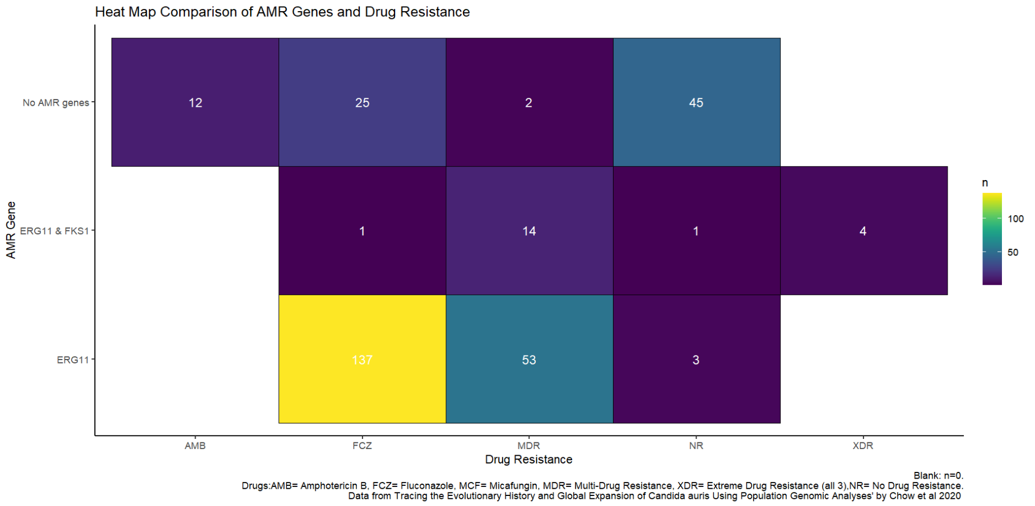
Drug Resistance & AMR Genes
Notes:
Main points: high count of isolates that have mutation in ERG11 gene also have FCZ resistance or MDR
Isolates with no AMR genes are more likely to also not have any drug resistance
ERG11 and FCZ connection actually pretty well studied and I could talk for another 10 minutes about the biochemistry/mechanism of it but like, time

Slide 7
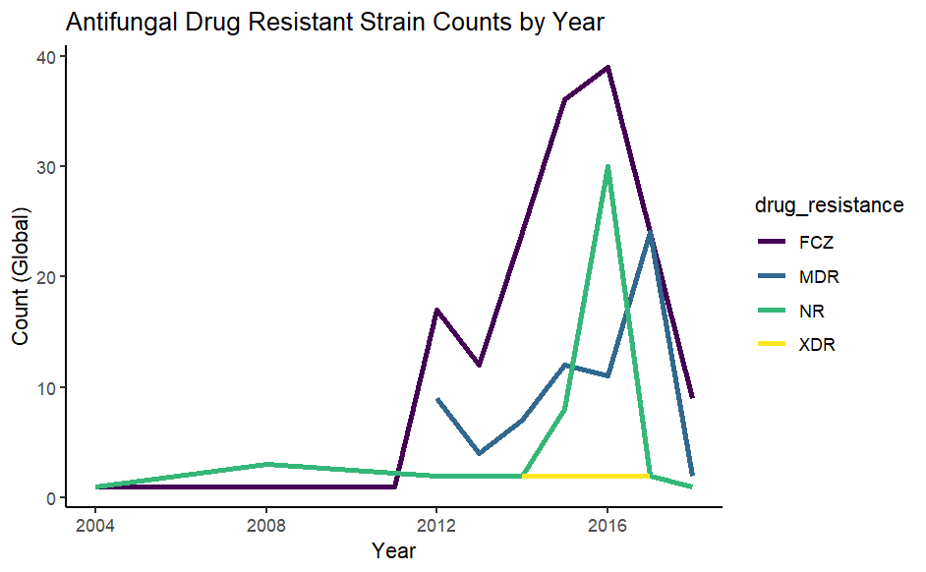
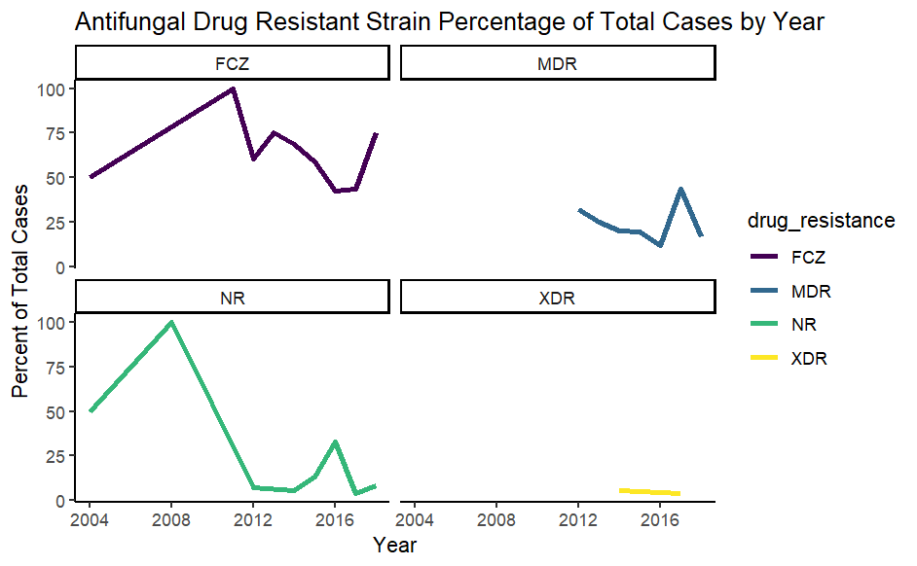
Drug Resistance Over Time

Slide 8
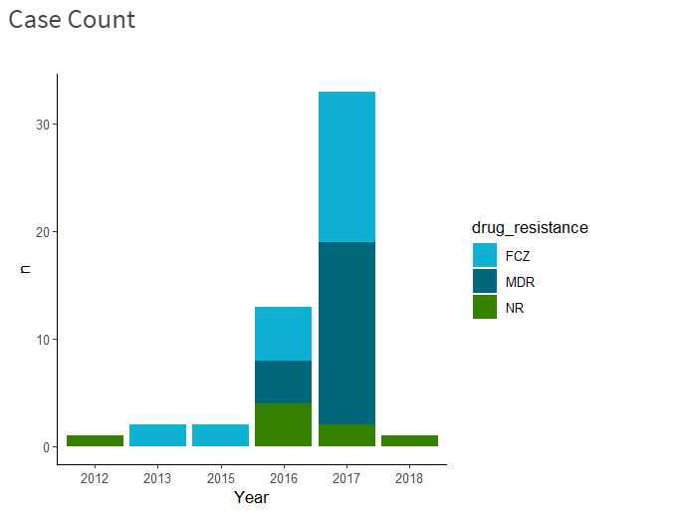
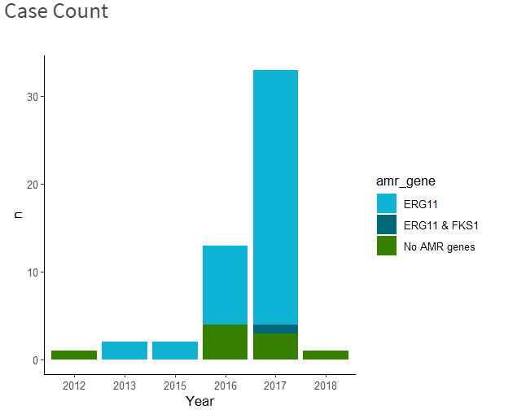
Shiny App

Slide 9

U.S. Surveillance
How has the incidence of C. auris changed over time?

Slide 10
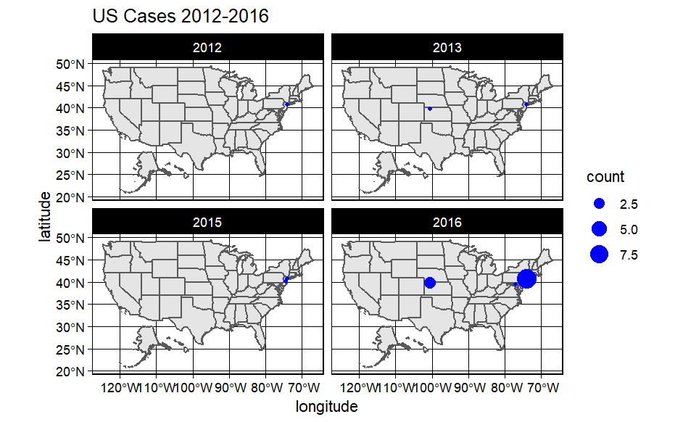
Geographical Spread Before 2016

Slide 11
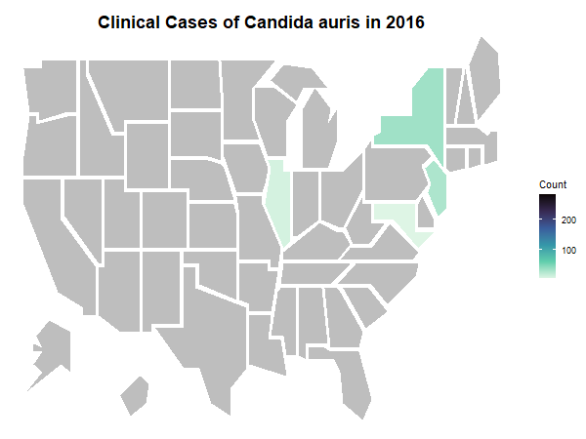
Reported Clinical Cases Since 2016
Most cases result from local spread within healthcare facilities
Risk factors:
extensive exposure to ventilator units
receiving healthcare in countries with C. auris transmission

Slide 12
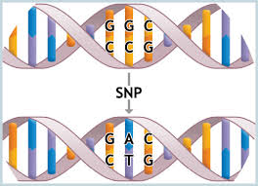
NCBI Isolate Data
Does genetic variation determine severity of infection?

Slide 13
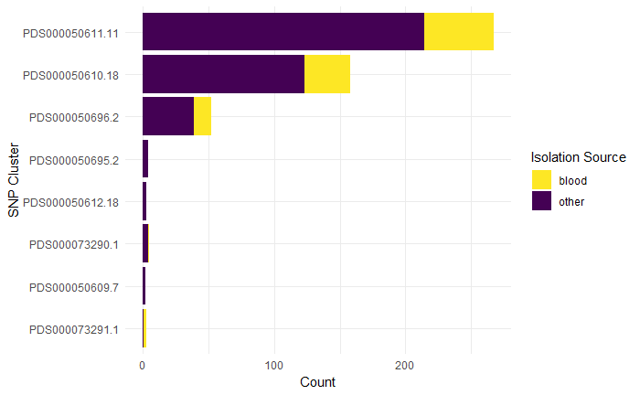
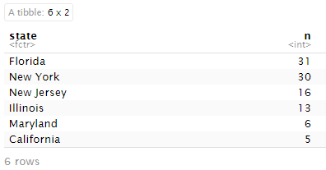
Proportions of Blood Isolations Across SNP Clusters
Locations of Blood Isolates:
*A SNP cluster is a group of isolates whose genomes are closely related

Slide 14

Google Trends
Can surveillance of C.auris Google search queries help identify outbreaks?

Slide 15
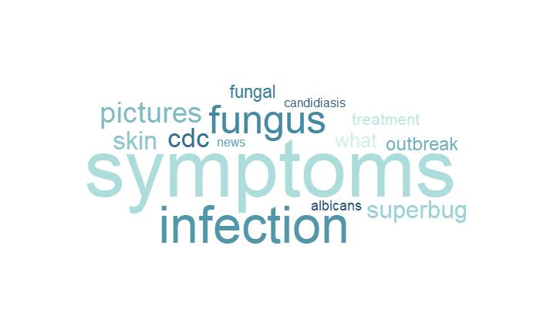
Most Popular Query Topics Since 2004

Slide 16
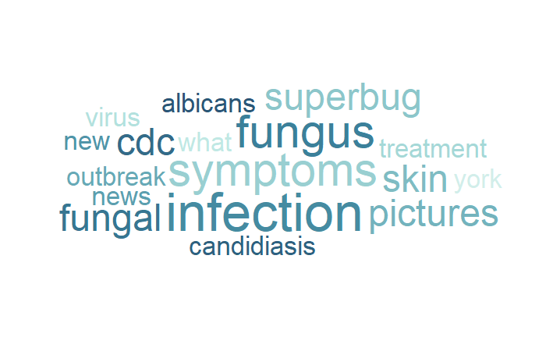
Rising Query Topics

Slide 17
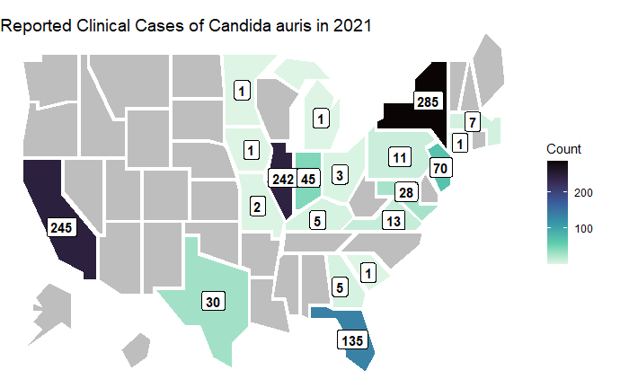
Can Google Trends detect outbreaks?

Slide 18

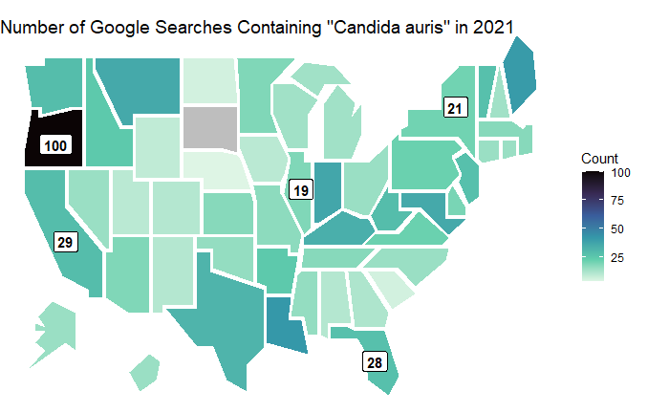
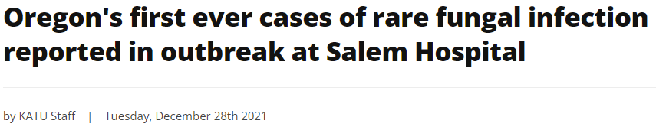
Can Google Trends detect outbreaks?
Why is C. auris searched the most in OR?

Slide 19

CONCLUSIONS
AMR genes and drug resistance:
AMR genes important in mechanism of drug resistance
Both increasing over time
US surveillance data:
C. auris is an emerging public health threat
Google Trends data:
Interesting to monitor public awareness

Slide 20

01
TECHNICAL DIFFICULTIES

Slide 21
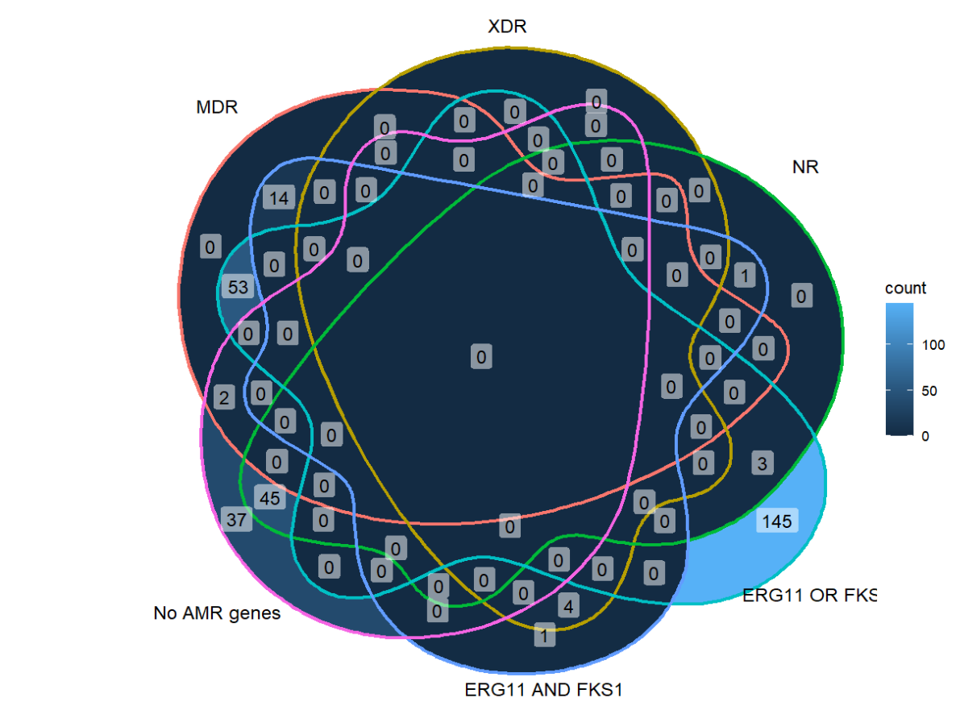
Appropriate Visuals
Over Complicated Venn Diagram
I don’t think anyone can get any information from this
Heat map was much clearer!
Lesson learned: having the right type of plot for your data is important

Slide 22
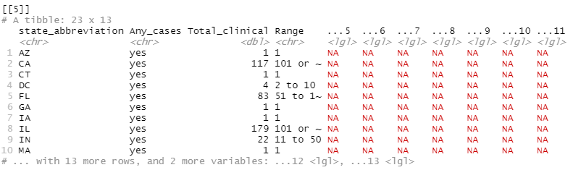
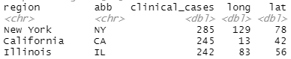
Joining Data
6 CDC data sets (2016 - 2021)
Inconsistent columns
Needed to add year column before merging into one dataset
Needed to add state name column before joining with map data

Slide 23
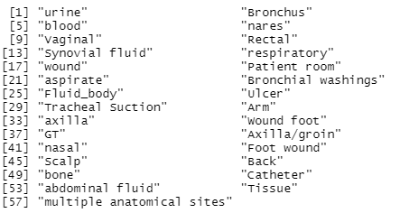
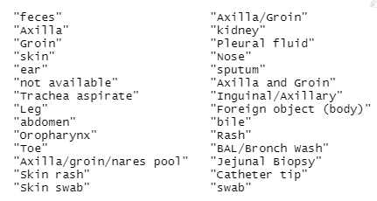
Cleaning Text Data
Needed to extract & categorize info from isolation source & isolation location columns
Notes:
Col values: mutate() + str_replace()
Categorize: case_when() + str_detect()

Slide 24

Things I wish I had written down somewhere before starting this project
%!in% (not in) operator with Negate(`%in%`)
Categorizing character vectors with case_when() + str_detect()
Built in State dataset
tm package
How to use purr

Slide 25

Thanks!

